Slide 1
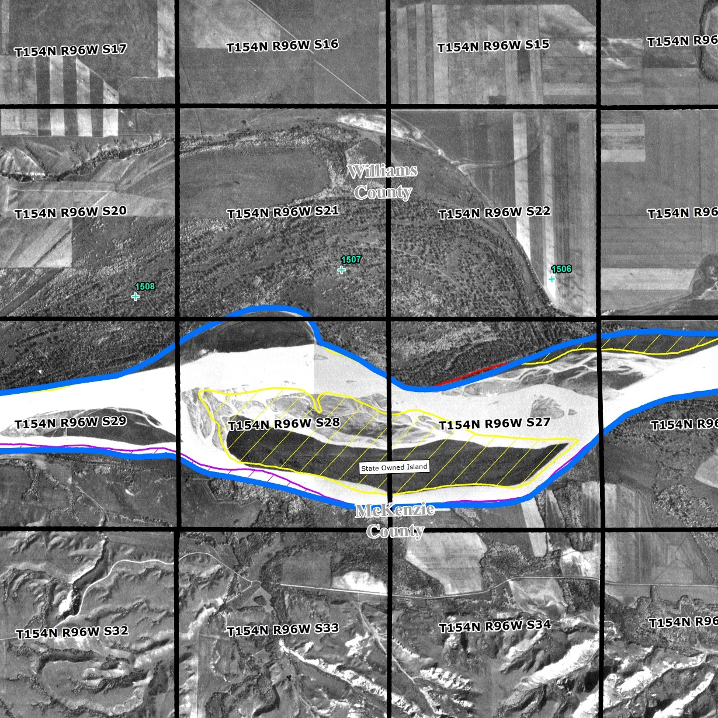
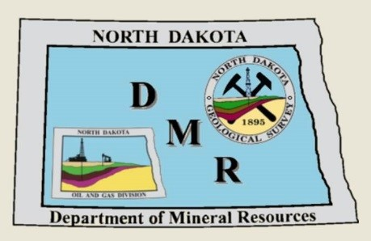
ORDINARY HIGH WATER MARK OF THE MISSOURI RIVER BED
April 17, 2018

Slide 2
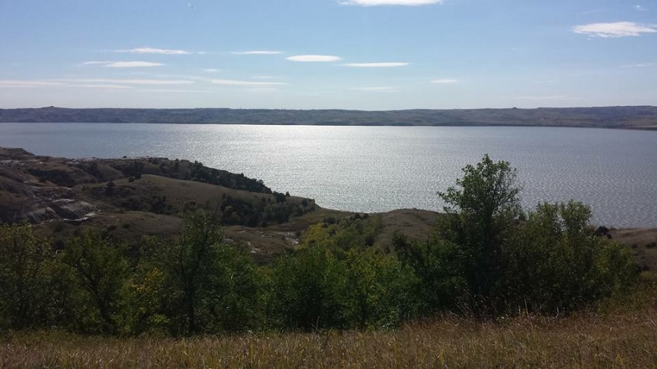
OUTLINE
Introductions
Review project understanding and approach
OHWM definition
Data sources and compilation
OHWM delineation methodology
Results
Questions

Slide 3
INDUSTRIAL COMMISSION Department of Mineral Resources
Lynn Helms - Director
Edward Murphy – State Geologist
1,000+
clients
1 focus:
YOU

Slide 4
WENCK ASSOCIATES, INC.
Who is Wenck?
Project team members present
Joel Toso – Project Manager
Dan Ackerman
Luke Toso
Employee-owned engineering and consulting firm.
Established in 1985.
275+ Employees.
13 offices.
1,000+
clients
www.wenck.com

Slide 5
RINKE NOONAN LAW FIRM
Government & Water Law
Who is Rinke Noonan?
North Dakota Government Clients
Bottineau County Water Resource District
Foster County Water Resource District
Wells County Water Resource District
Environmental Compliance & Permitting
Clean Water Act (U.S. Army Corps)
Food Security Act of 1985, as amended (USDA – NRCS)
National Wildlife Refuge System (U.S. Fish & Wildlife Service)
N.D.C.C. chs. 61-32 & 61-16.1
Midwest Practice (ND, SD, MN, IA)
Watershed Districts and Drainage Districts
Public Drainage Authorities
Water Management Litigation
Celebrating 50 years.
28 Attorneys & 60 Staff
Upper Midwest Leading Law Firm in Water Law.
Water Law Attorneys
Kale Van Bruggen
John Kolb
Jerry Von Korff

Slide 6
PROJECT SCOPE AND PURPOSE
OHWM analysis of historic Missouri River bed under what is now Lake Sakakawea.
Initiated by State Legislation for reviewing the delineation of state-owned land.
Presumptive determination is the US Army Corps of Engineers (USACE) survey.
Goal – Determine if clear and convincing evidence is present that the USACE survey does not accurately represent the OHWM of the historic Missouri riverbed per state law.

Slide 7
OHWM DEFINITION
Based on State case law:
The OHWM is the point at which the presence of action of the water is so continuous as to destroy the value of the land for agricultural purposes, including hay lands.

Slide 8
OHWM DEFINITION
Based on State case law:
Occurs “at the level where significant, major, and substantial terrestrial vegetation ends or ceases to grow.”
Accretions presumed to be above the OHWM and are not sovereign.
Low-lying flat lands where the OHWM impracticable to determine due to inconclusive aerial photography or vegetation analysis is presumed above OHWM.

Slide 9
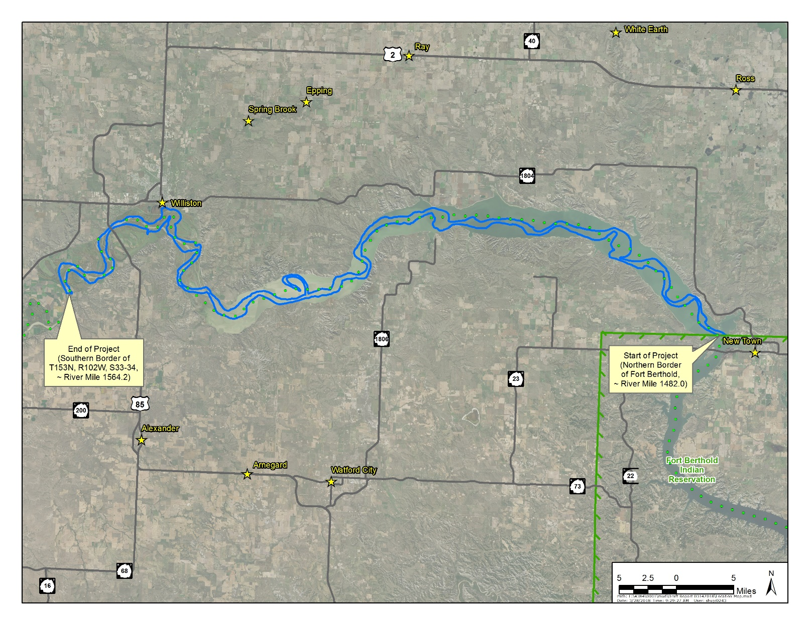
PROJECT AREA

Slide 10
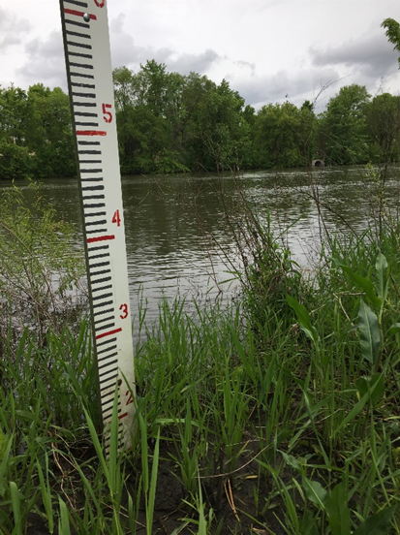
SCOPE OF WORK
Data gathering
Data analysis
Presentation of findings
Publication of findings
Comment review and final recommendations

Slide 11
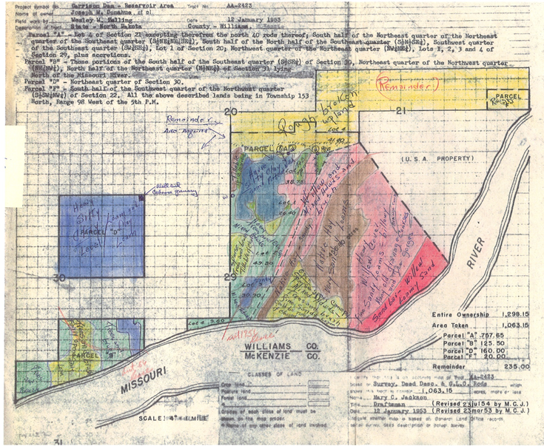
DATA COMPILATION
State provided data – digital copies of aerial photography, USACE survey, and topography.
USACE – historical records (appraisal documents) at Riverdale office, cross sections and details from Omaha office.
USGS – flow records.
Research case law.

Slide 12
LEGAL RESEARCH – State Case Law
Existing law focuses on delineating the OHWM of current waterbodies.
Aerial photographs can provide evidence of the change in land characteristic.
ACCRETIONS: to be sovereign, accretions must be from natural causes and on the bank of the river above the OHWM.
Lack of cropping history or hay harvest that is more than intermittent frequency.
Soil types or classifications that are unusable for any productive purpose.
Vertical changes in elevation coupled with a change from wetland to terrestrial vegetation.

Slide 13
LEGAL RESEARCH
CLEAR & CONVINCING STANDARD
61-33.1-03(1) directs that the presumed OHWM is the Army Corps survey completed for surface rights acquisition and supplemental plats created by the branch of cadstral survey of the BLM.
61-33.1-03(3) – the review must determine whether clear and convincing evidence establishes that a portion of the Corps survey does not reasonably reflect the OHWM of the historical Missouri riverbed channel under state law.

Slide 14
LEGAL RESEARCH
CLEAR & CONVINCING STANDARD (continued)
Clear & convincing evidence – the evidence must be such that the trier of fact is reasonably satisfied with the facts the evidence tends to prove as to be led to a firm belief or conviction. Zundel v. Zundel, 278 N.W.2d 123, 130 (N.D. 1979).
The “clear & convincing evidence” requires less evidence than that required to meet the standard of “beyond a reasonable doubt.” Id.

Slide 15
DATA ANALYSIS
Analyze Corps survey data with river flow data, hydraulic model, geo-referenced aerial photography, topography, and identify discrepancies.
Document areas where clear and convincing evidence exists based on OHWM definition and legal interpretation.

Slide 16
DATA PROCESSING
Geo-referencing aerial photography.
Geo-referencing improvements of the USACE survey.
Modeling river elevations for frequent flood events (USGS flow data and USACE cross sections).

Slide 17
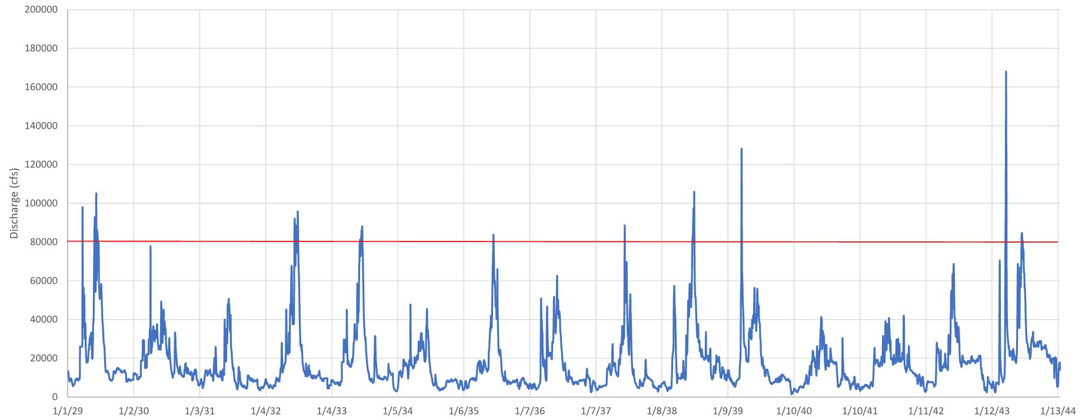
USGS FLOWS (PRE-DAM)

Slide 18
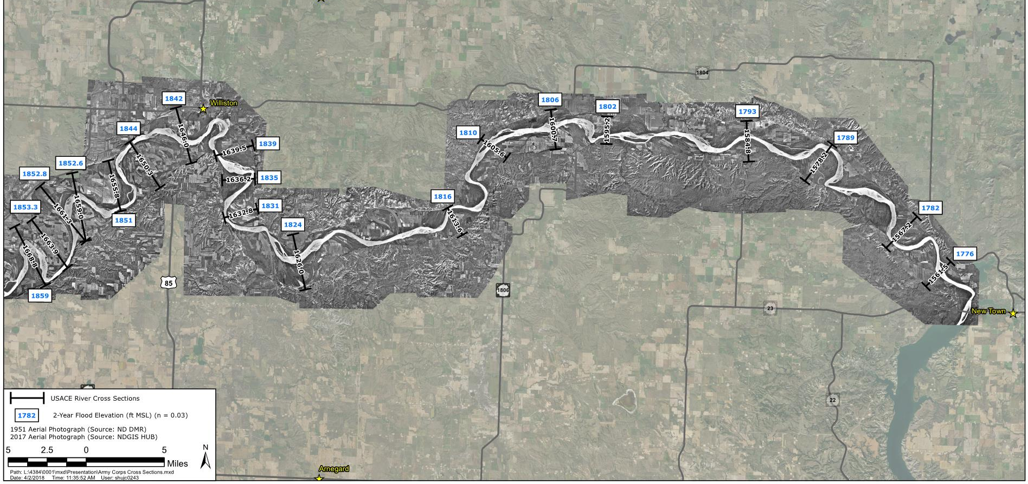
USACE CROSS SECTIONS AND HYDRAULIC MODELING

Slide 19
DELINEATION METHODOLOGY
Topographic information with flow levels from modeling.
Aerial photo interpretation.
Appraisal documents.

Slide 20
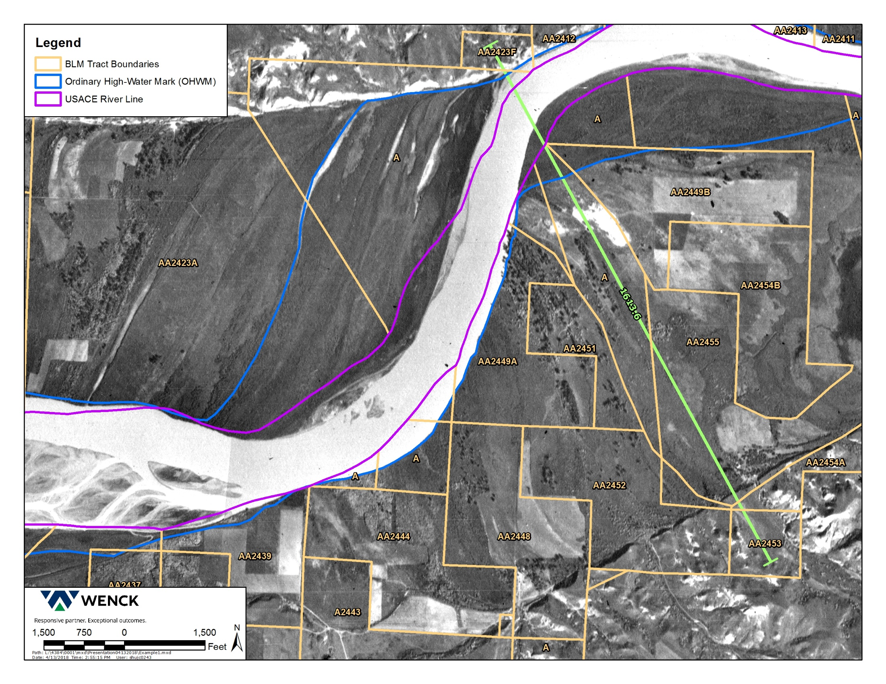
Data Analysis
***insert Jordan’s graphics here

Slide 21
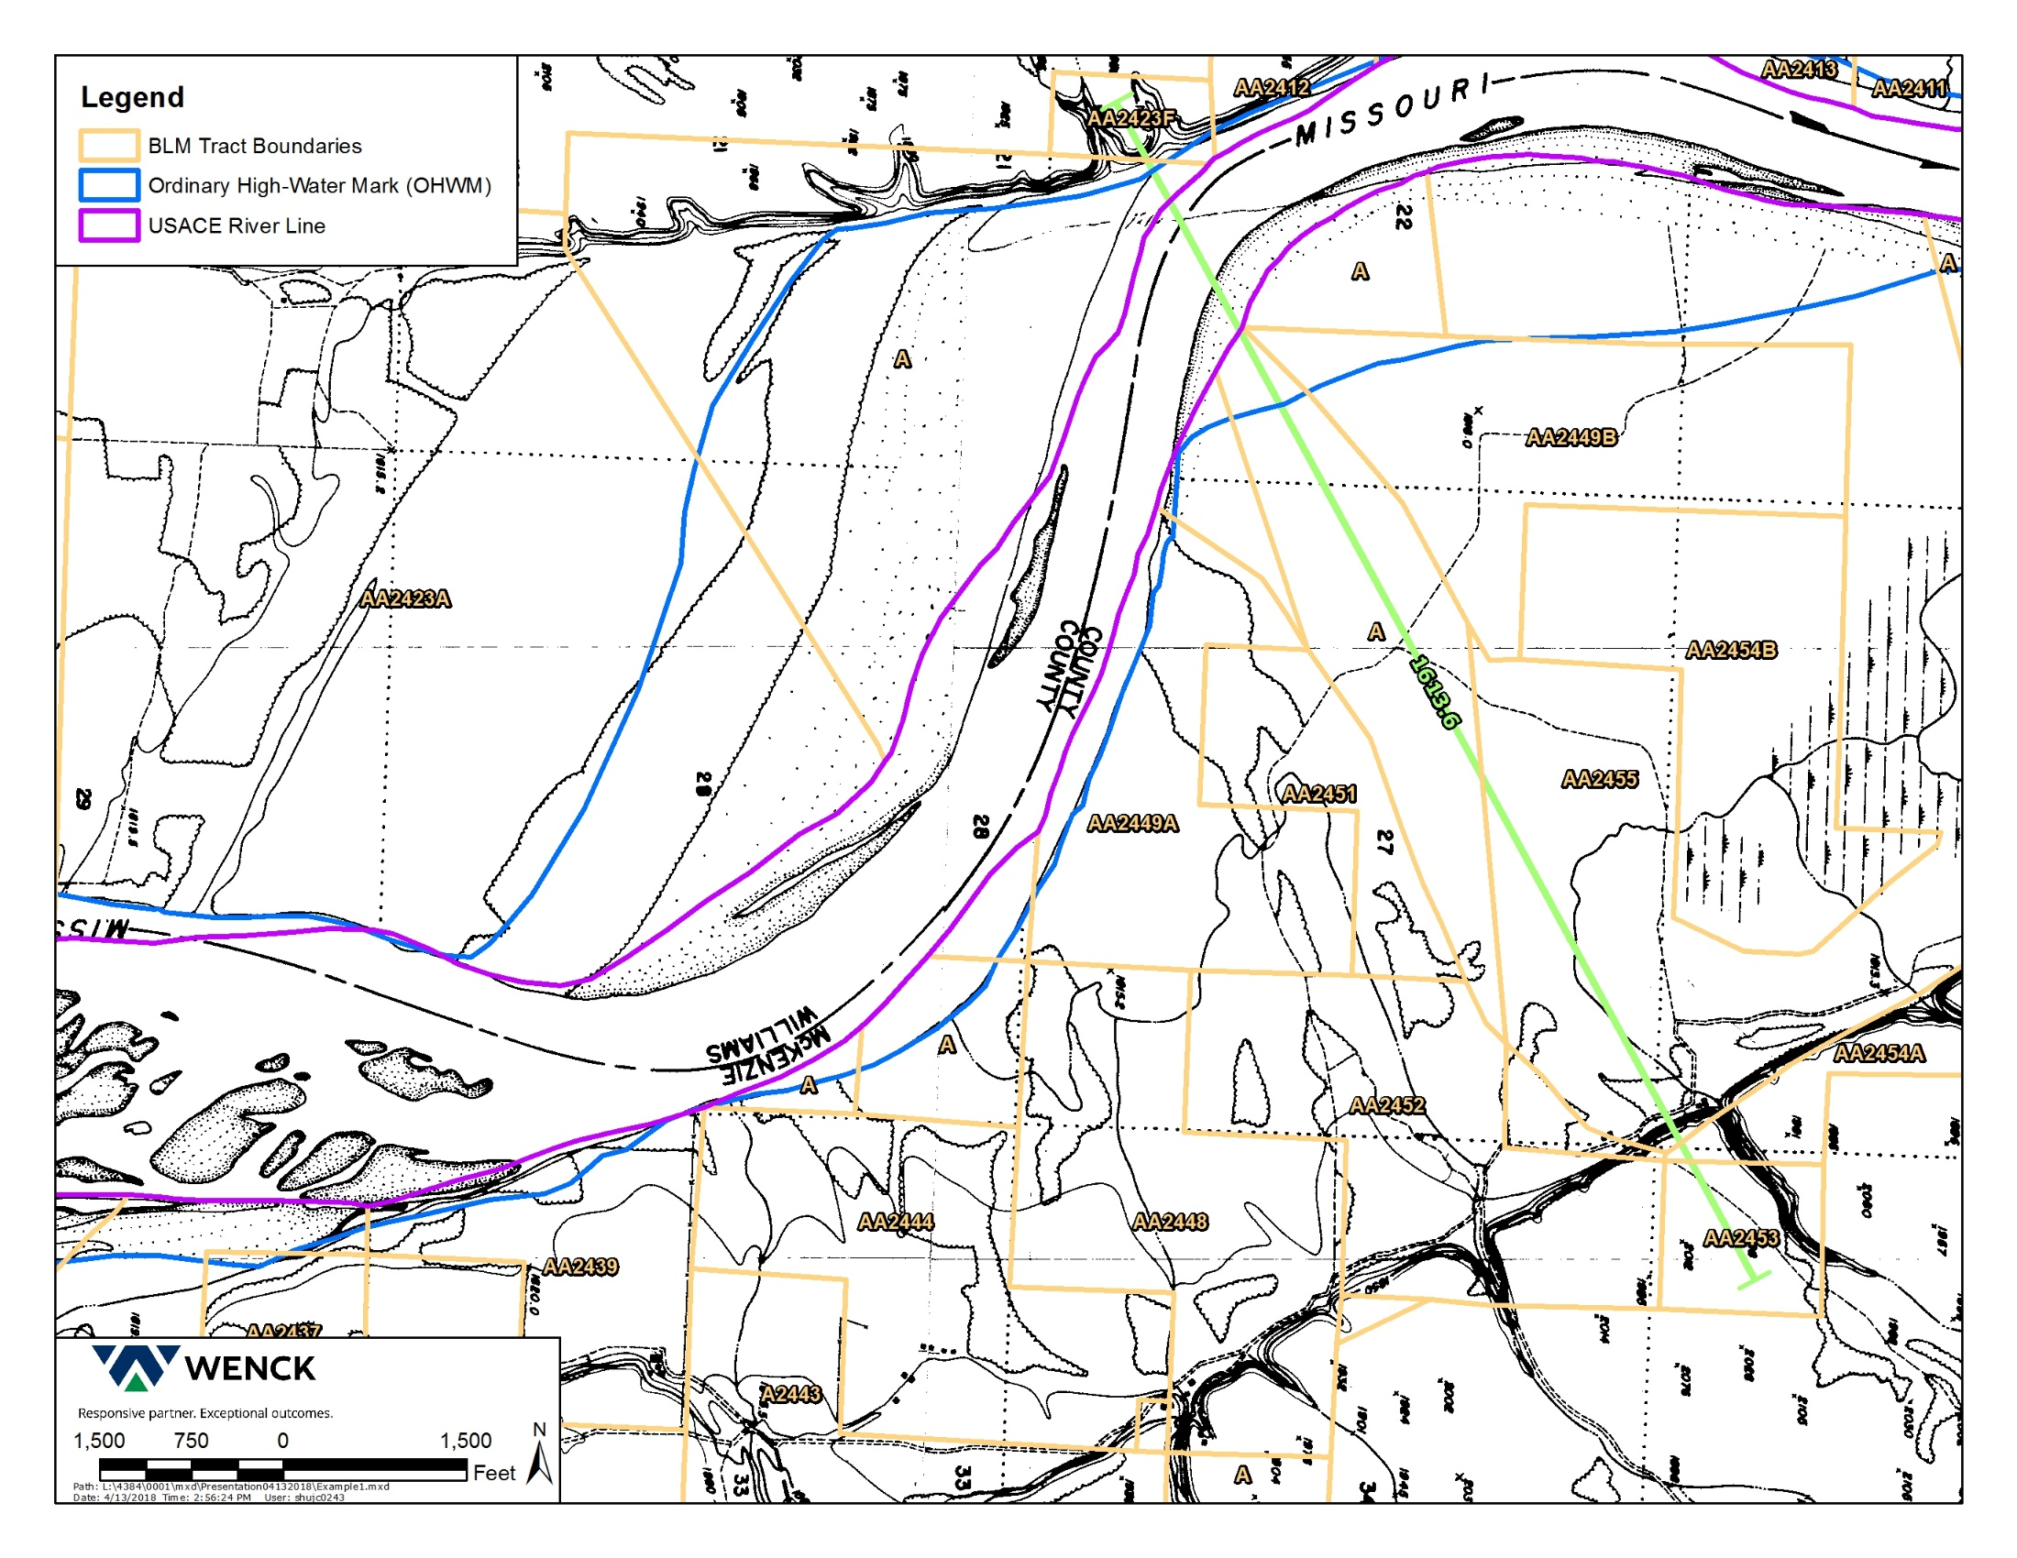
1816.0
1815.2
1815.2

Slide 22
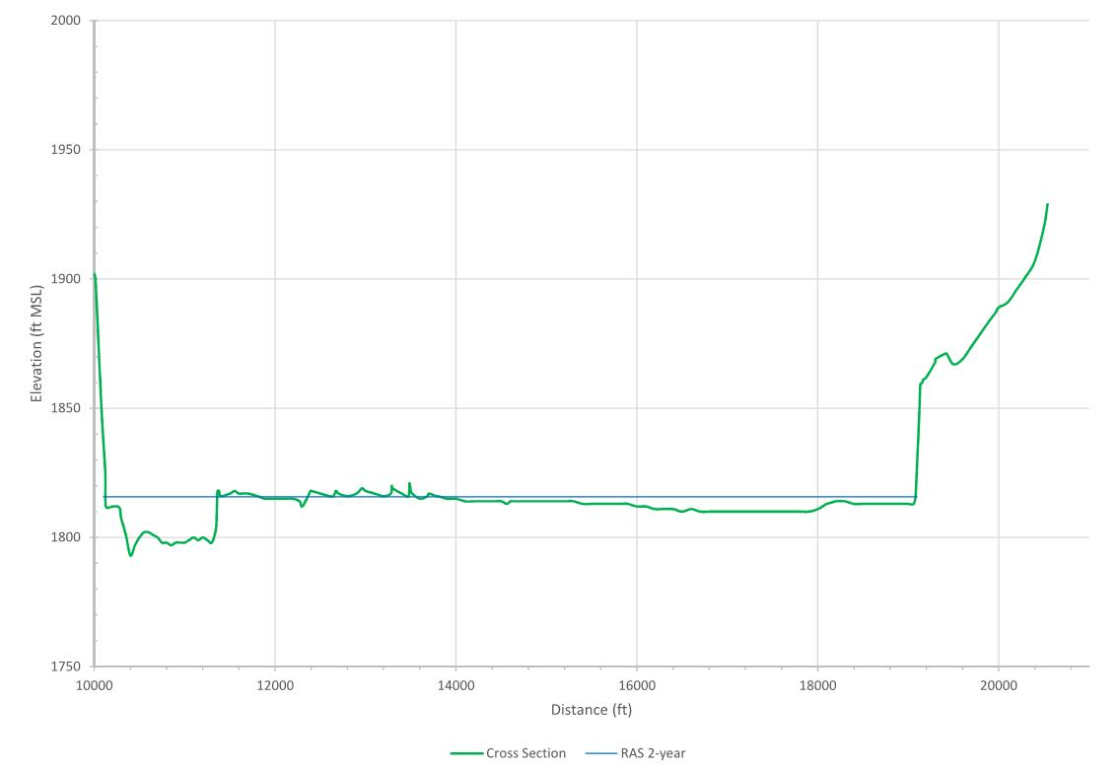
USACE CROSS SECTION 1613.6

Slide 23
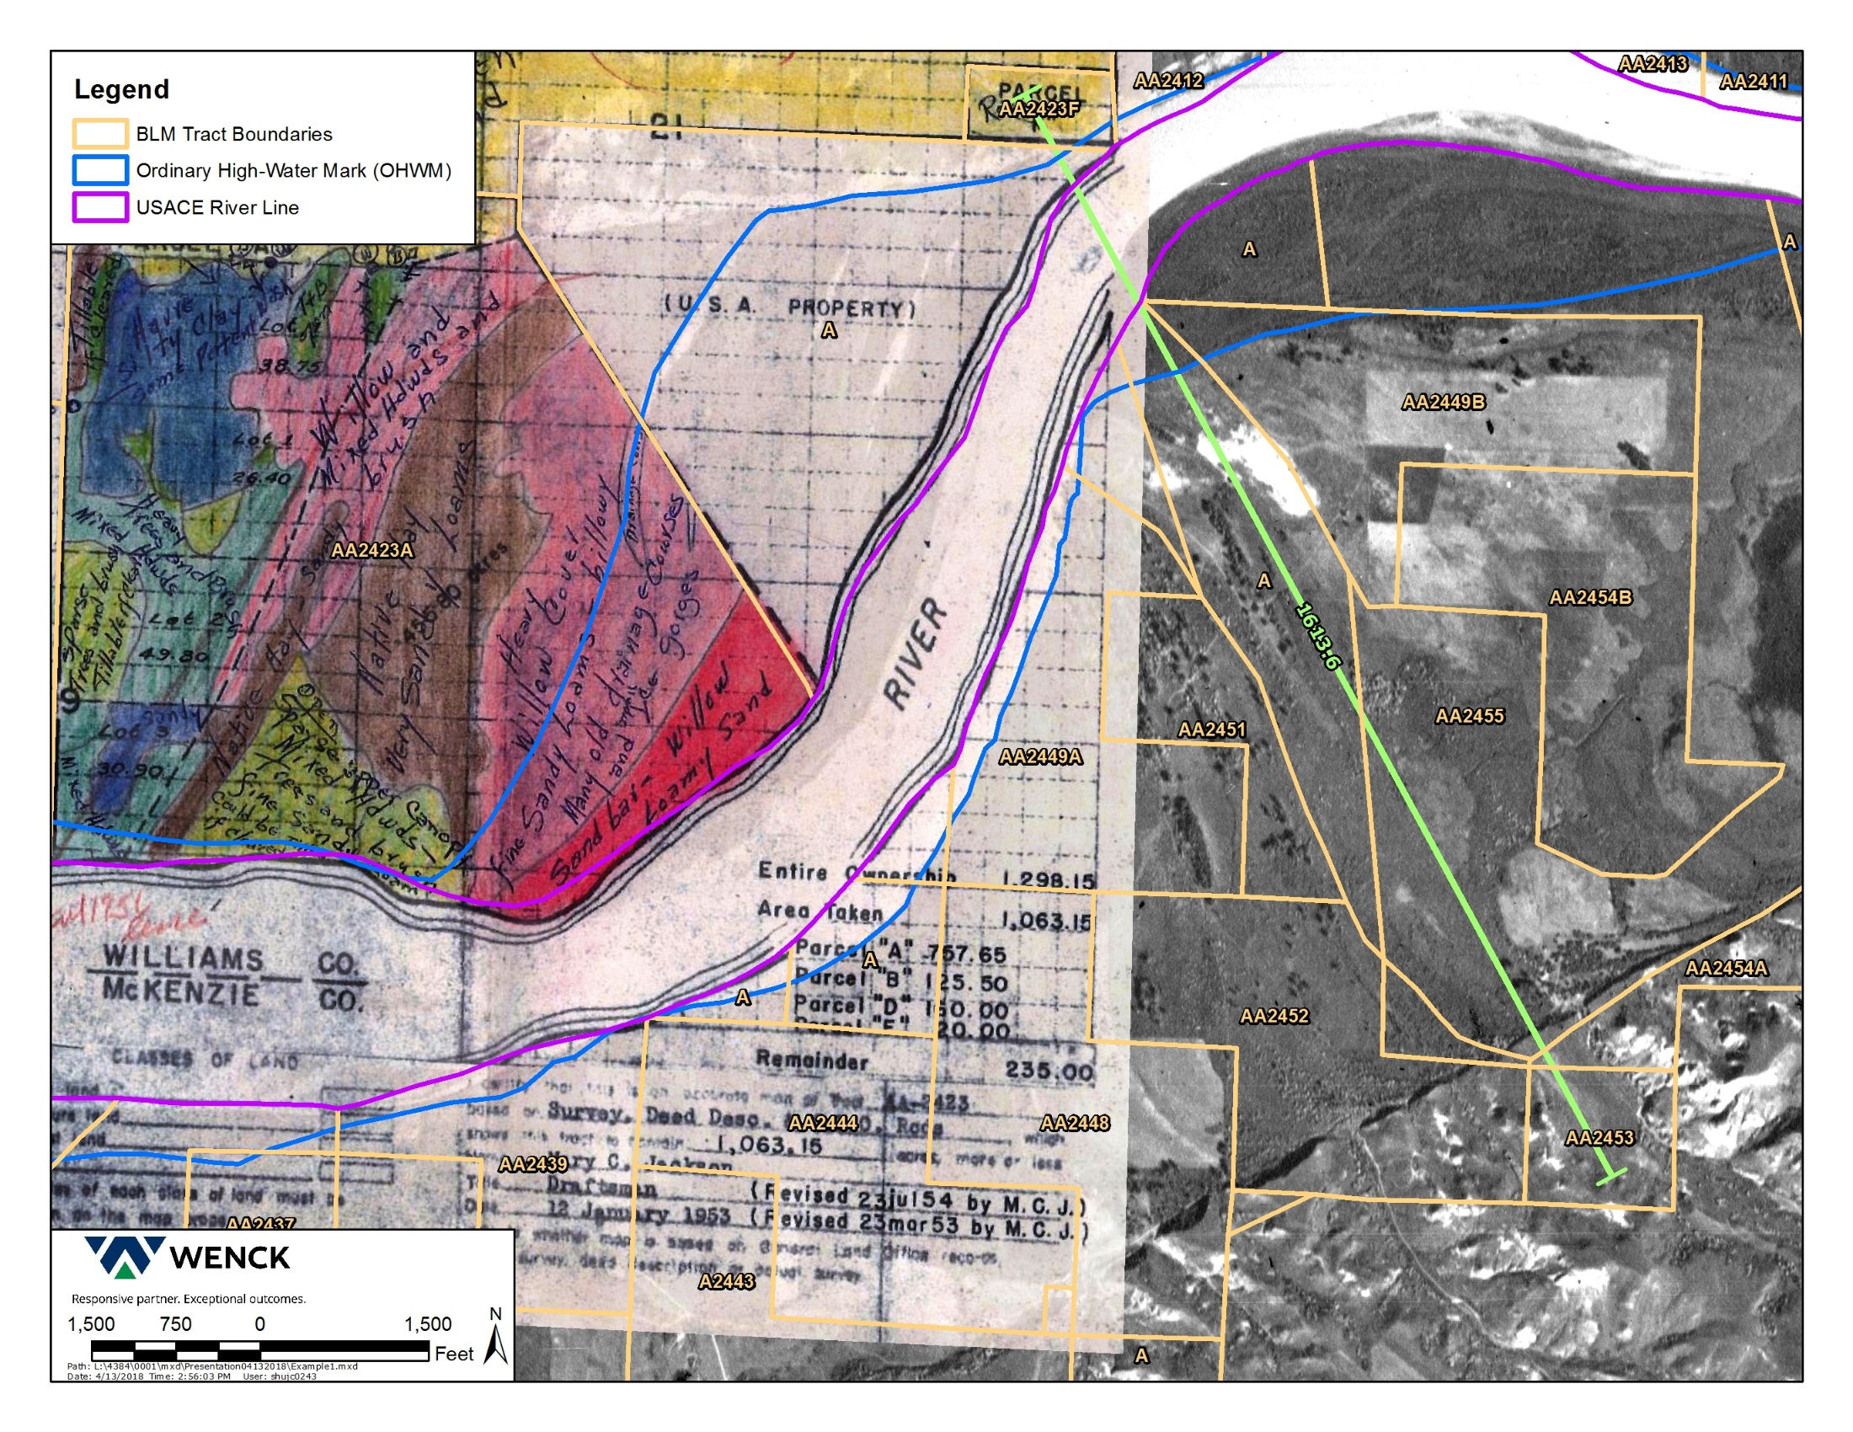
Data Analysis
***insert Jordan’s graphics here

Slide 24
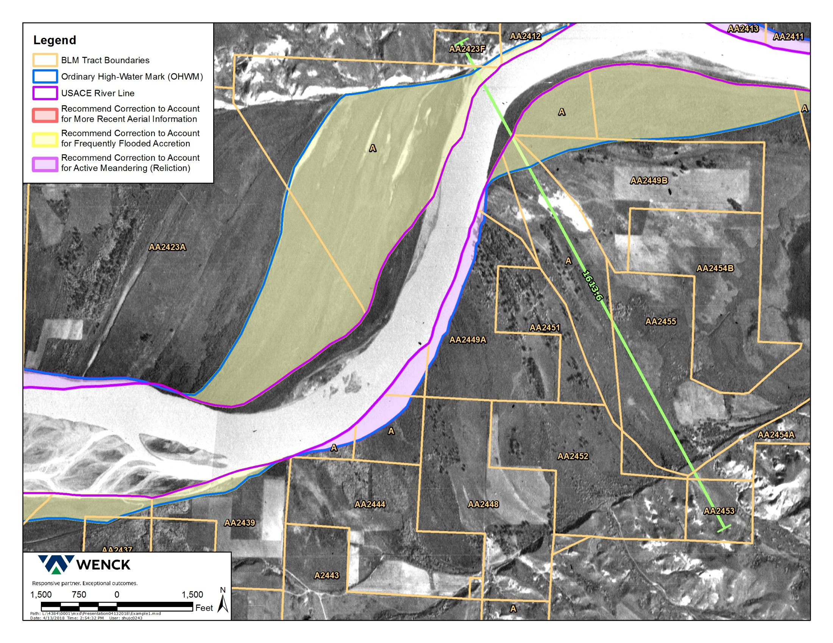
Data Analysis
***insert Jordan’s graphics here

Slide 25
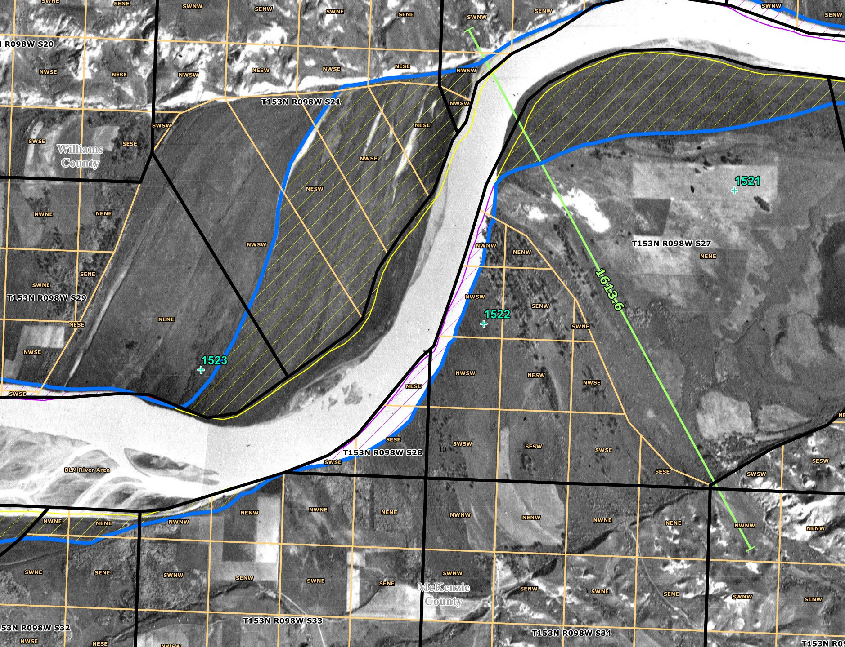

Slide 26
TABLE 2 RESULTS

Slide 27
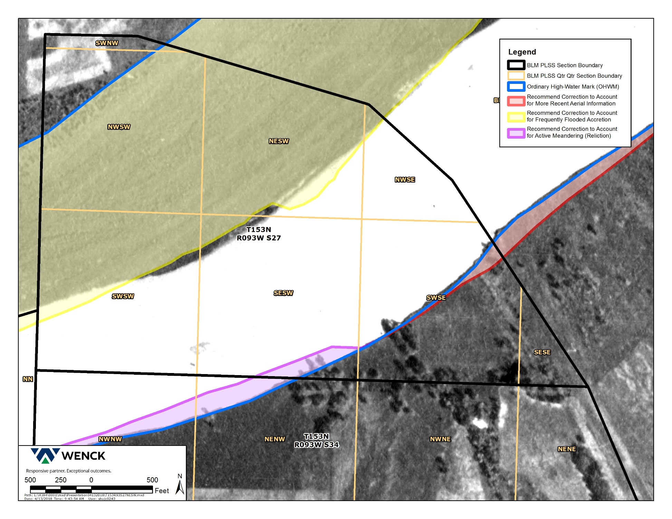
Data Analysis
***insert Jordan’s graphics here
From Figure 4 of report.
All of the NESW is below the OHWM.
There is 1.1 acres less below the OHWM in the SWSE.

Slide 28
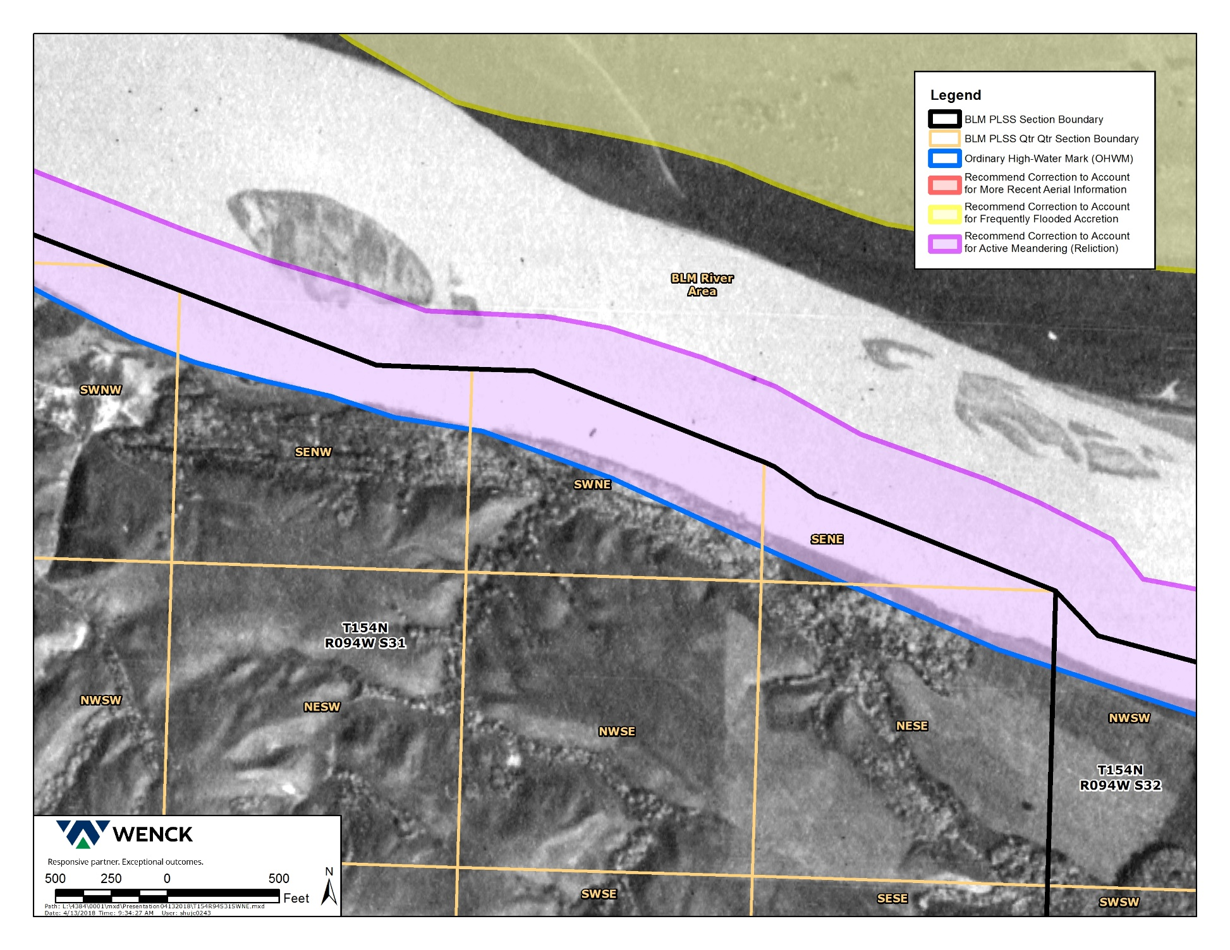
Data Analysis
***insert Jordan’s graphics here
From Figure 5 of report.
The SENW does not intersect the USACE survey.
It does in the current delineation.

Slide 29
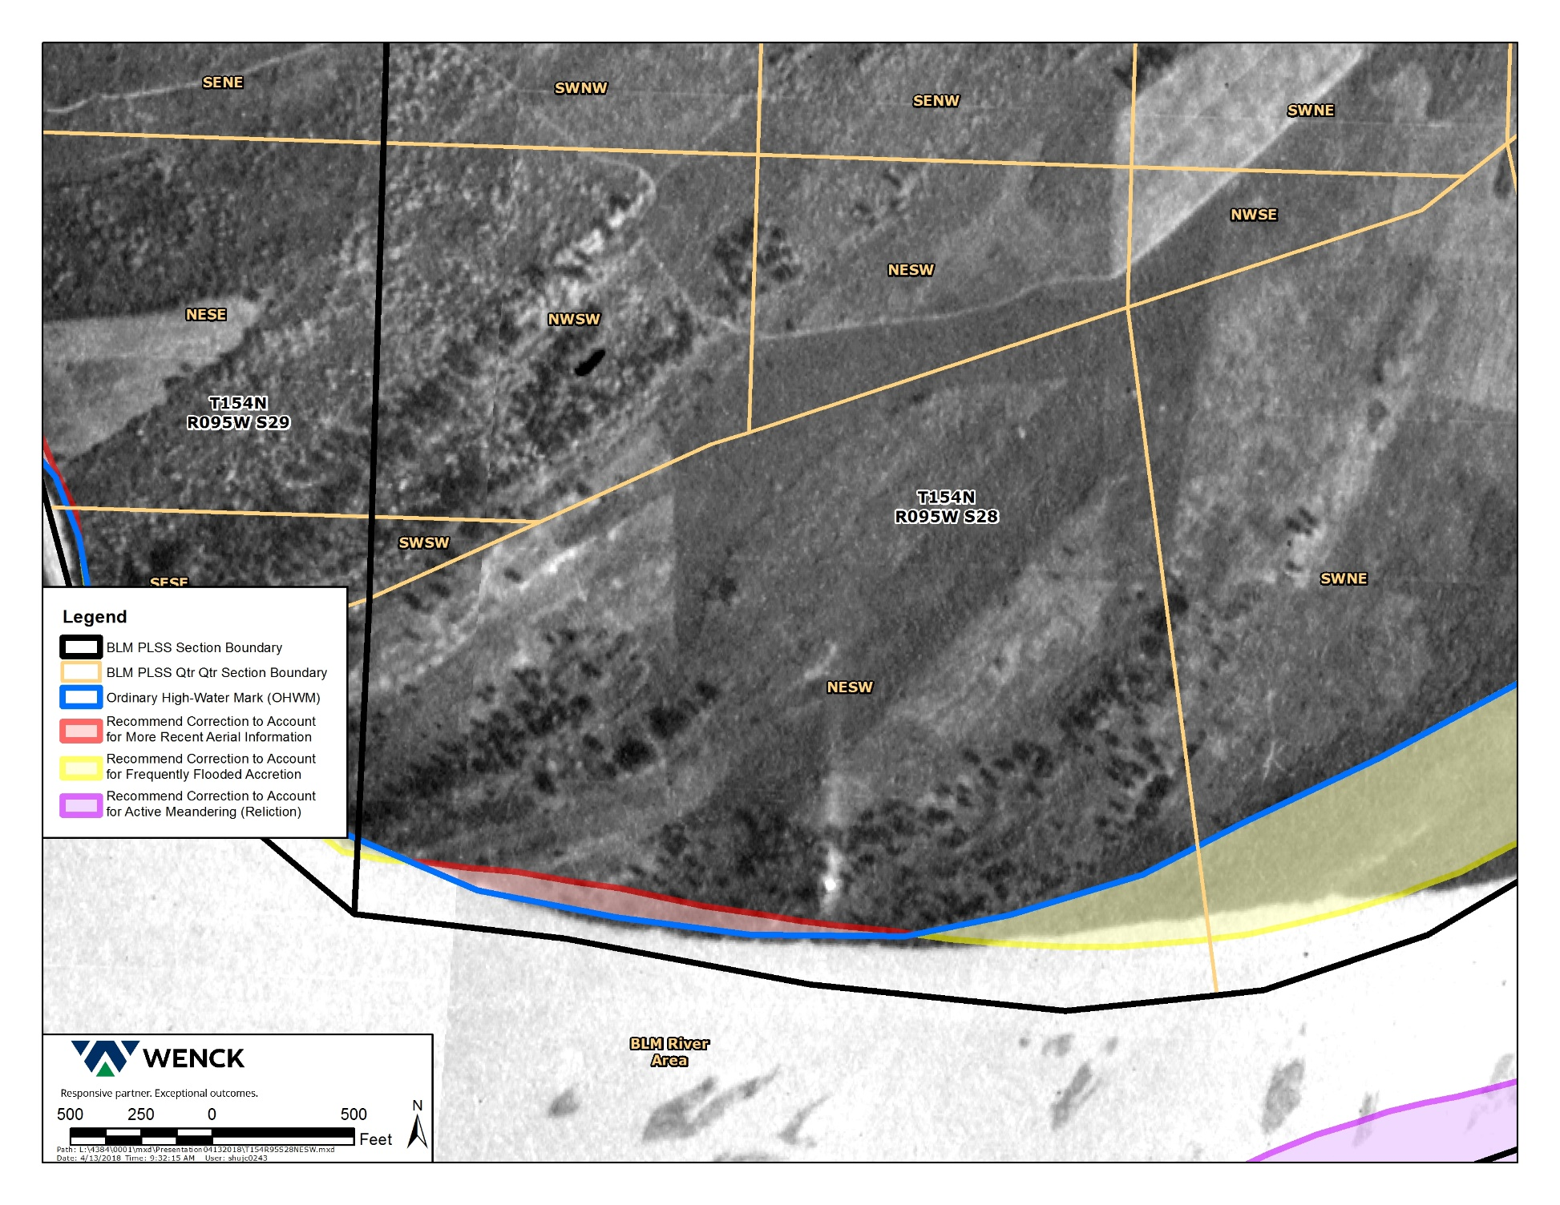
Data Analysis
***insert Jordan’s graphics here
From Figure 6 of report.

Slide 30
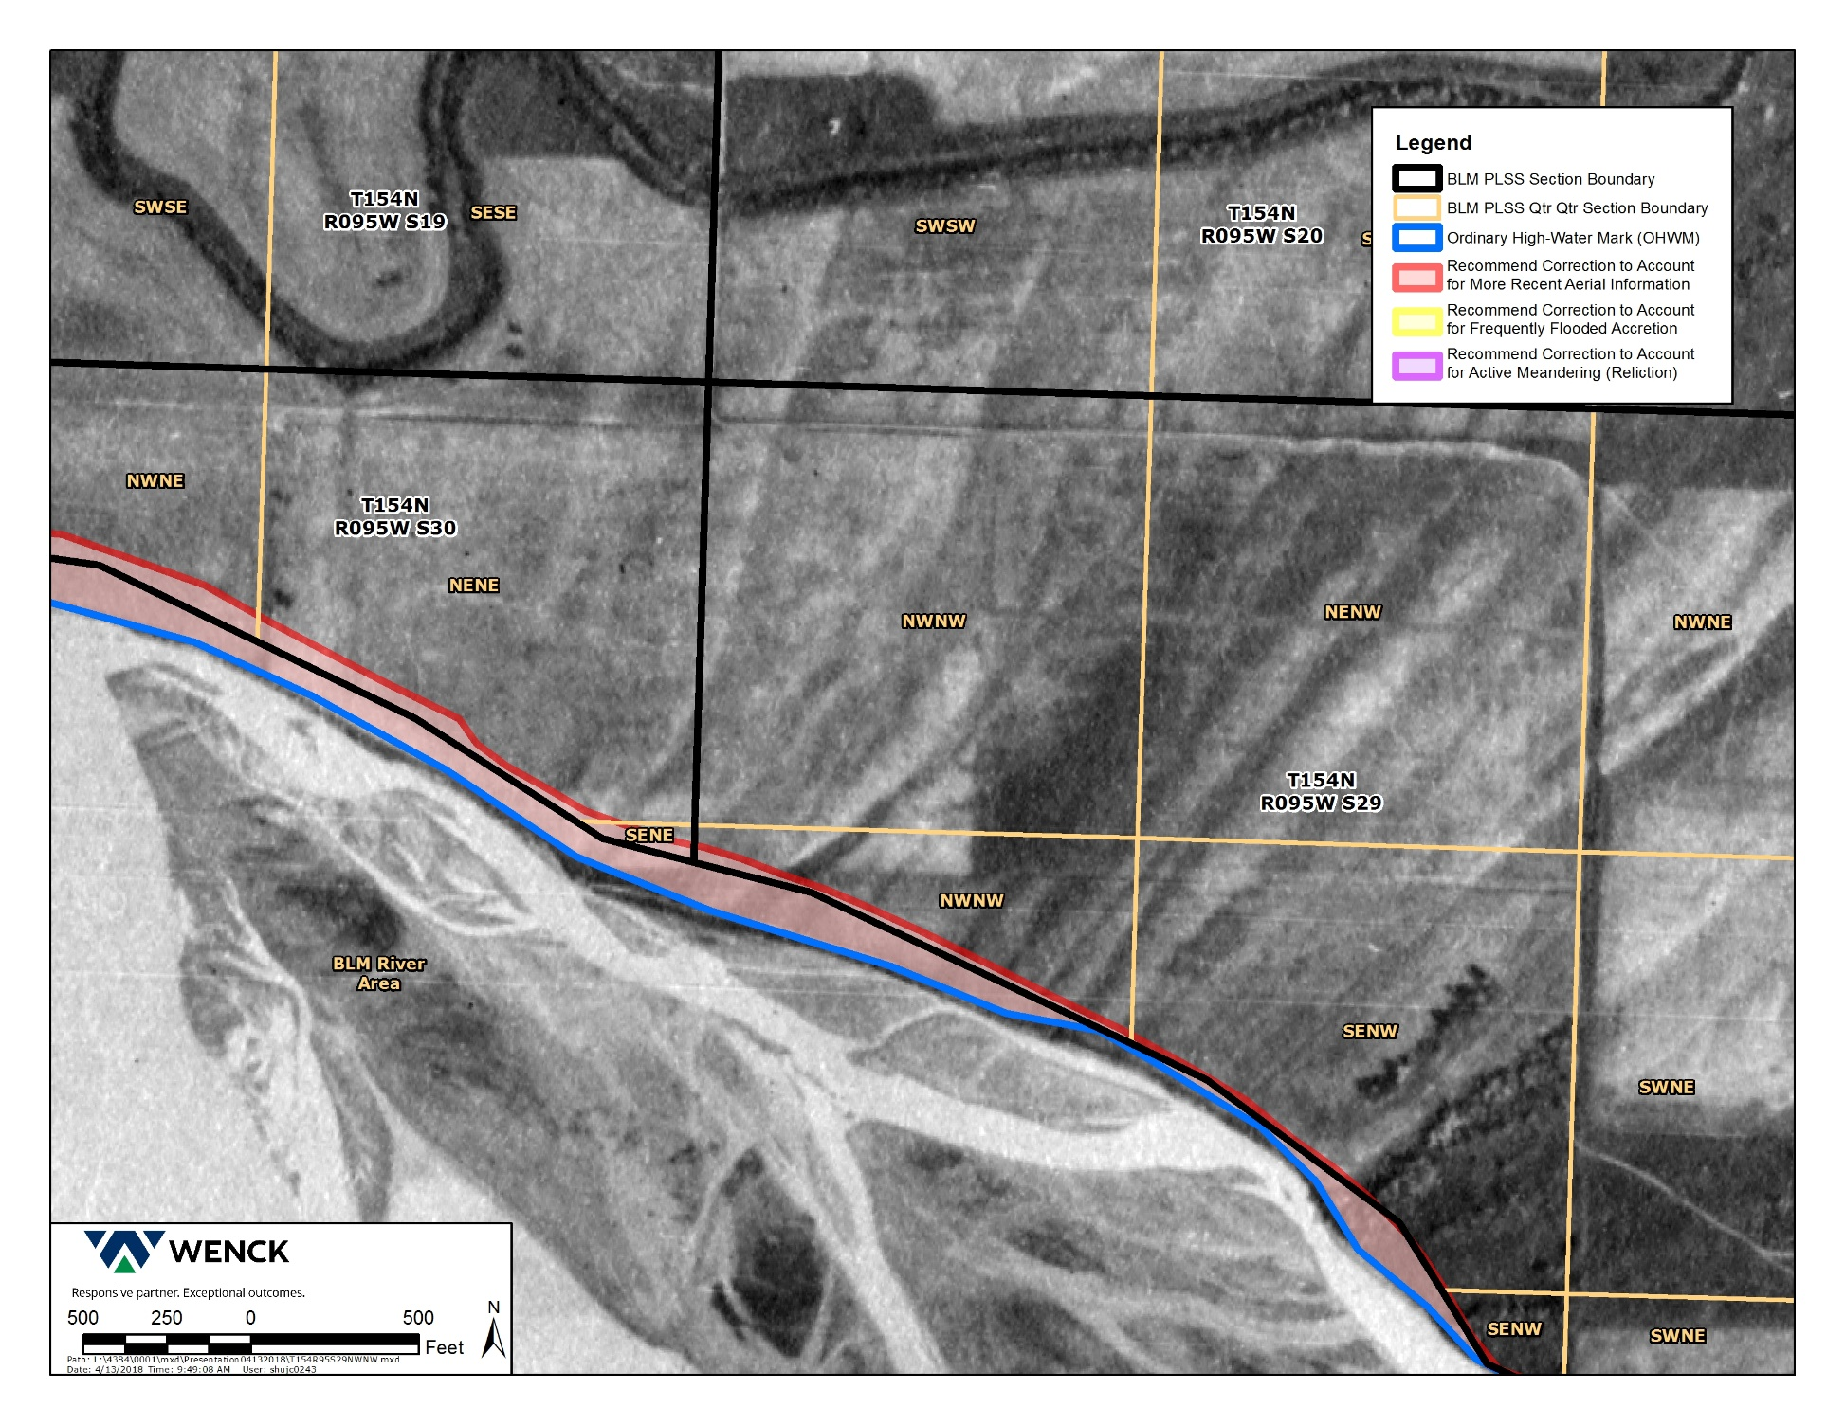
Data Analysis
***insert Jordan’s graphics here
From Figure 7 of report.
The NENE intersects the USACE, but not the current delineation.

Slide 31
OVERALL RESULTS
(from River Mile 1482 to 1553.5).
USACE OHWM | 16,687 acres
Project OHWM | 27,089 acres
Total increase in OHWM | 10,402 acres
Total increase in OHWM | 162%

Slide 32
NEXT STEPS
Publication of the findings - The report and supporting information to be made available to the public through a link on the DMR website.
60 day public comment period.
Public hearing (~June 26).
Address comments and provide recommendations to Commission.

Slide 33
QUESTIONS?

